Slide 1

Heat Diffusion Inspired
Event Data Analysis
Event‑Based Vision & Physics‑Inspired Modelling
Tahsin Mostafiz
July 29, 2025

Slide 2
Introduction & Motivation
time
Event cameras capture asynchronous brightness changes with microsecond latency and high dynamic range
No motion blur: the asynchronous event stream demands new algorithms
Research question: can heat diffusion reveal motion patterns in event data?
Asynchronous events
Each dot represents a brightness change
[1]

Slide 3

Heat Diffusion & Heat Kernel
Heat equation:
∂u/∂t = k(∂²u/∂x² + ∂²u/∂y²)
Fundamental solution (heat kernel):
Φ(x,t) = 1/(4πkt) · exp(-‖x‖²/(4kt))
General solution via convolution:
u(x,t) = ∫ Φ(x-y,t) g(y) dy
Single event diffusion
[2]

Slide 4

Heat Diffusion Simulation
Single event
Multiple events
Heat spreads radially from each event
Multiple sources superpose linearly

Slide 5
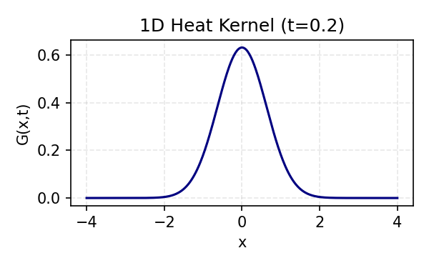
Dirac δ, Gaussian & Heat Kernels (1D & 2D)
Distribution | Peak at x=0 (t→0) | Integral ∫
Dirac δ | ∞ | 1
1D Gaussian (Heat Kernel) | ∞ as t→0 | 1
2D Gaussian (Heat Kernel) | ∞ as t→0 | 1
1D: G₁(x,t) = (4πt)^{-1/2}·e^{−x²/(4t)}
2D: G₂(r,t) = (4πt)^{-1}·e^{−r²/(4t)}
1D Heat Kernel
All kernels integrate to 1
As t→0, the heat kernels become sharply peaked and converge to Dirac δ
2D Heat Kernel
[2]

Slide 6
Precomputation for Efficiency
Naïve Approach
Precomputed Approach
Event data
Precompute kernel
Loop over all pixels
Event window
Compute convolution
Project & sum
Heatmap
Heatmap
Kernel precomputation speeds up diffusion by an order of magnitude: memory usage increases but per‑event updates are constant‑time.

Slide 7
Sliding Window Precomputation
Use a fixed temporal window to process recent events only
Precompute the heat kernel once and reuse it for incoming events
Project diffused heat of events inside the window onto the kernel
Ignore events outside the window to reduce computation and storage
time

Slide 8

Implementation Details
function precomputeHeatKernel(alpha) {
// Compute the diffusion kernel for the given diffusion coefficient α
// The heat kernel is a normalised Gaussian; don't recompute per event
return computeHeatKernel(alpha);
}
function accumulateEvents(events, kernel, windowSize) {
heatmap = zeros(imageWidth, imageHeight);
for each (x, y, t) in events within the last windowSize {
// Project the precomputed kernel onto the heatmap at the event position
heatmap += kernel placed at (x - kernel.width/2, y - kernel.height/2);
}
return heatmap;
}
For each non‑zero pixel within the event data, apply the diffusion equation — too slow!
Precompute the heat kernel first; reuse it for all events
Take a temporal window — anything outside the window is ignored
For each event point within the window, project the diffused heat onto the target kernel
No need to calculate diffusion for every event: saves a lot of time
Requires memory to store the precomputed kernel
Implementation Demo
(video placeholder)

Slide 9
Experimental Setup & Dataset
EVIMO captures indoor sequences with event‑based sensors
6‑DoF camera and object poses are recorded at 200 Hz
Pixelwise masks are provided at 40 Hz, alongside depth maps and RGB frames
The high temporal resolution allows capturing fast motion in low‑light conditions
Attribute | Value
Sensor Type | Event‑based (DVS)
Pose Frequency | 200 Hz
Mask Frequency | 40 Hz
Supports Depth & RGB | Yes
[3] [4]

Slide 10
Observations & Parameter Sensitivity
Heatmap Video
(placeholder)
Observations
Diffused heatmaps reveal underlying motion trajectories
The spread of the heatmap indicates relative speeds; random noise appears as isolated blobs that quickly dissipate
Parameter α
Small α produces slow diffusion, preserving detail but poorly capturing motion
Large α yields fast diffusion, blurring detail but capturing motion
α balances spatial sharpness and temporal smoothing

Slide 11
Event Diffusion: Masked vs Unmasked
Unmasked Output
(video placeholder)
Masked Output
(video placeholder)
What extra information is revealed in the heatmap videos?
Which object appears to move faster or slower from a single frame?
Can you trace the trajectory of the moving object?
What can you say about noise in the event data?

Slide 12
Limitations & Future Work
High volumes of events demand significant memory and I/O bandwidth
Precomputed kernels trade increased memory usage for speed
The current implementation is CPU‑bound; GPU acceleration could improve scalability
Investigate moving object segmentation and predictive tasks

Slide 13
Conclusion
Event cameras provide microsecond‑level temporal resolution and high dynamic range
Heat diffusion modelling provides continuous and interpretable representations of event data
Precomputed kernels drastically accelerate diffusion while preserving accuracy
Tuning α allows control over spatial detail and motion capture
Future work will extend to GPU acceleration and object segmentation
Thank you!
[1] [2] [3] [4]

